Slide 1
Machine Learning
AIML CZG565
M8 : Bayesian Learning
Course Faculty of M.Tech Cluster
BITS – CSIS - WILP

Slide 2

Machine Learning
Disclaimer and Acknowledgement
These content of modules & context under topics are planned by the course owner Dr. Sugata, with grateful acknowledgement to many others who made their course materials freely available online
We here by acknowledge all the contributors for their material and inputs.
We have provided source information wherever necessary
Students are requested to refer to the textbook w.r.t detailed content of the presentation deck shared over canvas
We have reduced the slides from canvas and modified the content flow to suit the requirements of the course and for ease of class presentation
Slide Source / Preparation / Review:
From BITS Pilani WILP: Prof.Sugata, Prof.Chetana, , Prof.Monali, Prof.Rajavadhana
External: CS109 and CS229 Stanford lecture notes, Dr.Andrew NG and many others who made their course materials freely available online

Slide 3
Course Plan
M1 | Introduction & Mathematical Preliminaries
M2 | Machine Learning Workflow
M3 | Linear Models for Regression
M4 | Linear Models for Classification
M5 | Decision Tree
M6 | Instance Based Learning
M7 | Support Vector Machine – Planned to be discussed in CS 15 or CS 16
M8 | Bayesian Learning
M9 | Ensemble Learning
M10 | Unsupervised Learning
M11 | Machine Learning Model Evaluation/Comparison

Slide 4
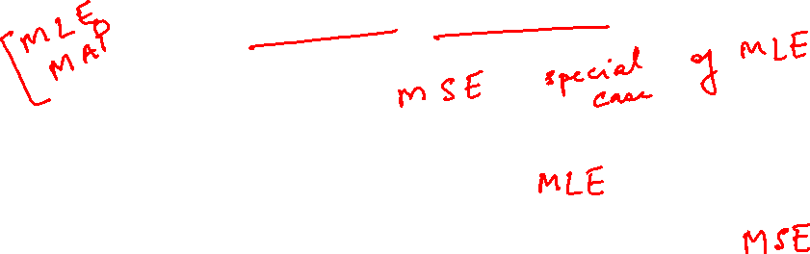
Bayesian Learning
Parameter Estimation
Where does the cost come from? - Logistic regression
Why least-squares cost function, be a reasonable choice? – Linear regression

Slide 5
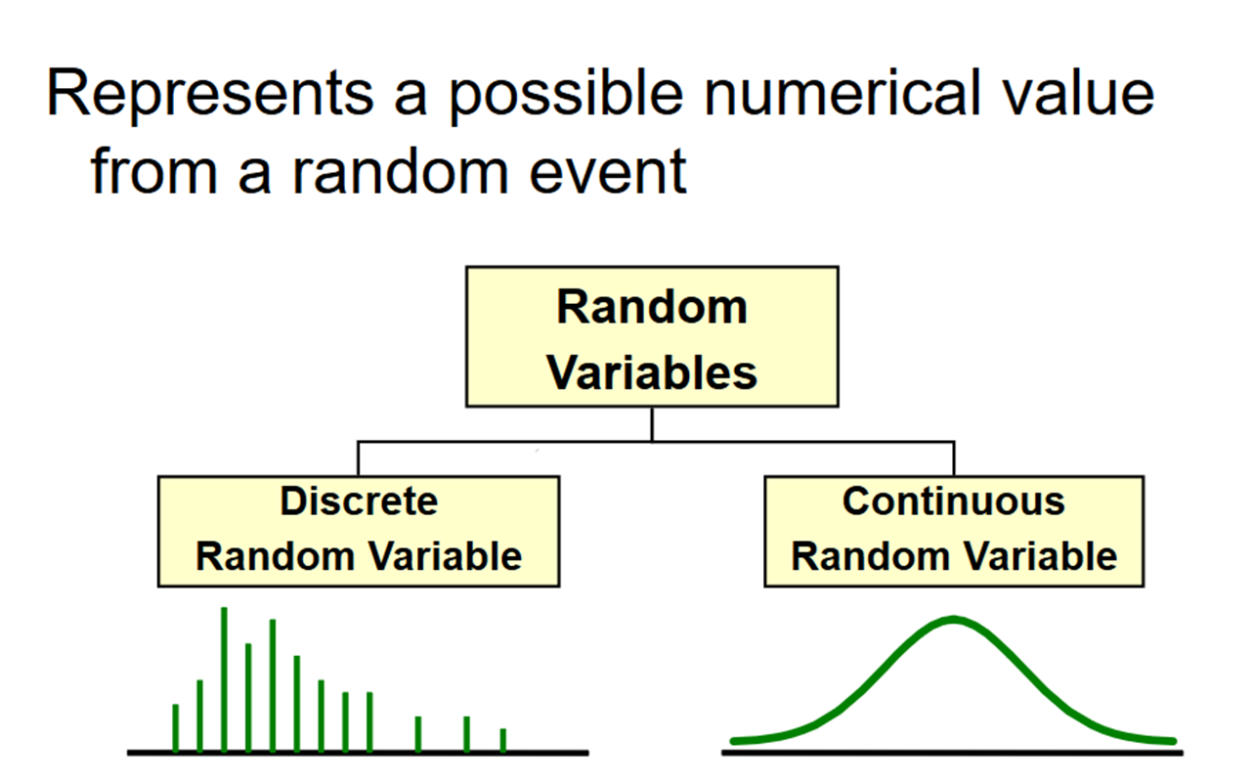
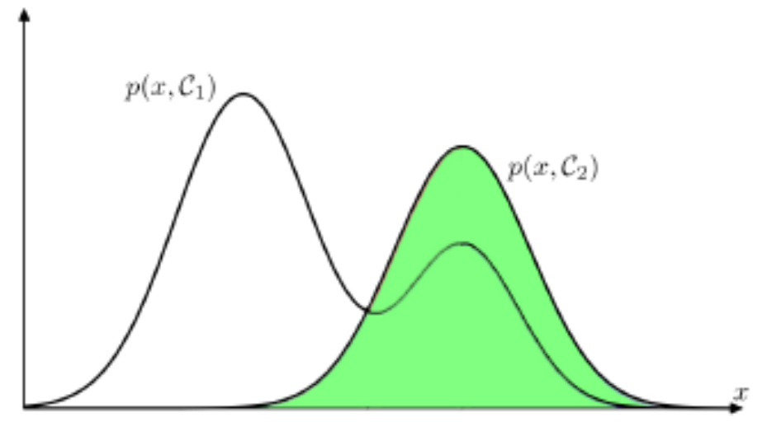
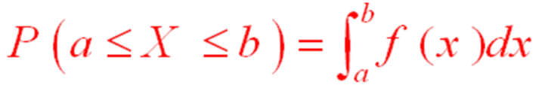
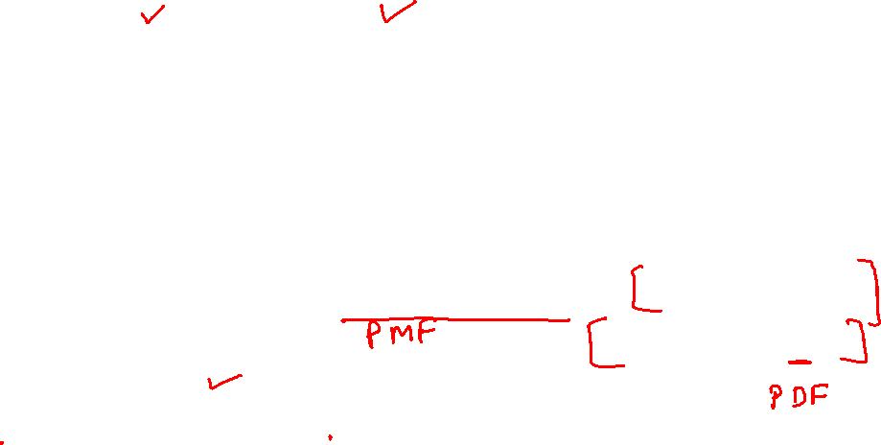
Distribution
Mileage (in kmpl) | Car Price (in cr)
9.8 | 10.48
9.12 | 1.75
9.5 | 6.95
10 | 2.51
Mileage (in kmpl) | Car Price (in cr)
Neutral | High
Less | Low
Neutral | Medium
More | Low
Mileage (in kmpl) | Car Price (in cr)
9.8 | High
9.12 | Low
9.5 | High
10 | Low

Slide 6
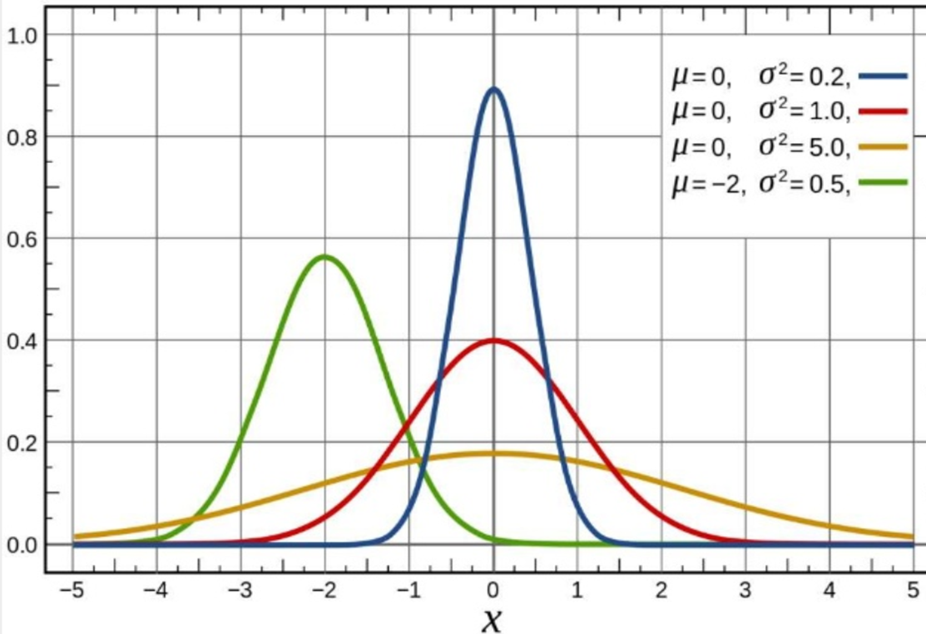
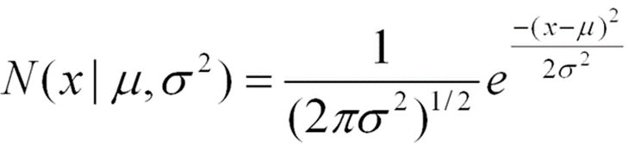
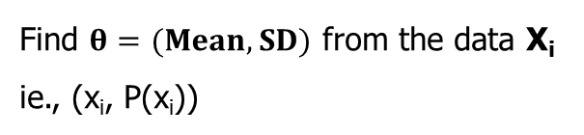
Parameter Estimation
𝜃 is the parameter of a distribution. 𝜃 can be a vector of parameters
Distribution = model + parameter 𝜃
Find $θ=(Mean, SD)$ from the data X_{i}
ie., (x_{i}, P(x_{i}))

Slide 7
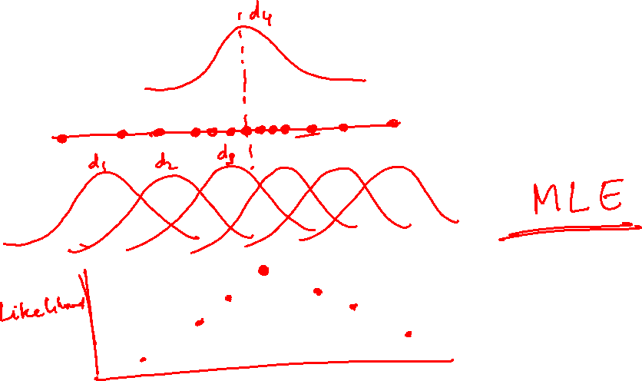

Slide 8

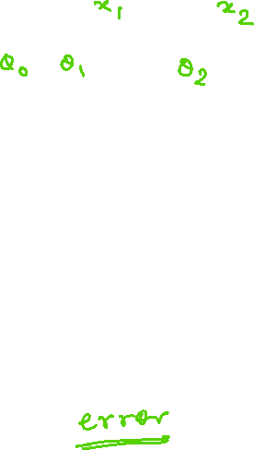

Parameter in ML
Mileage (in kmpl) | Car Price (in cr)
9.8 | 10.48
9.12 | 1.75
9.5 | 6.95
10 | 2.51
CarPrice = 8.5 + 0.5 Mileage – 1.5 Mileage²
Parameters : ($θ$₀, $θ$₁, $θ$₂)
Mileage (in kmpl) | Car Price (in cr)
9.8 | High
9.12 | Low
9.5 | High
10 | Low
CarPrice $=\frac{1}{1+e^{−\text{8.5 + 0.5 }\text{Mileage}\text{ – 1.5 }\text{Mileage}\text{2}}}$

Slide 9
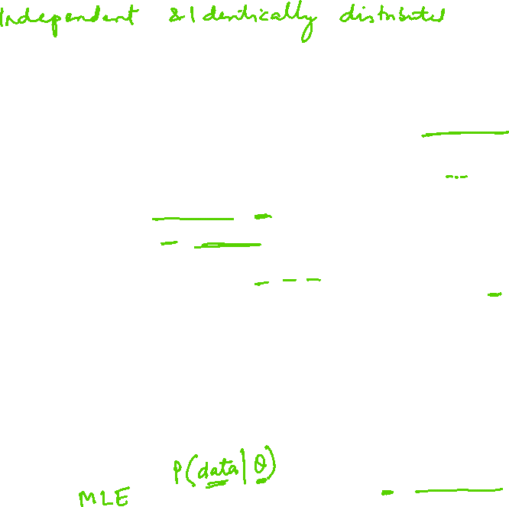


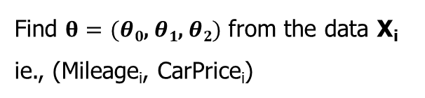
Parameter Estimation in ML
Mileage (in kmpl) | Car Price (in cr)
9.8 | 10.48
9.12 | 1.75
9.5 | 6.95
10 | 2.51
Assumption: Data are__
  IID samples: X₁…X_{n}
  where all X_{i} are independent and have the same distribution.
  Either same PMF (discrete) or same PDF (continuous)
f (X | 𝜃)
  Likelihood of different values of X depends on the values of our parameters 𝜃
  f( ) is either PDF or PMF
CarPrice = 8.5 + 0.5 Mileage – 1.5 Mileage²
y^{(i)} = θ^{T} x^{(i)} + ε^{(i)}
ε^{(i)} ∼ N(0, σ²)
Parameters : ($θ$₀, $θ$₁, $θ$₂)
Find $θ=(θ\text{0}\text{, }θ\text{1}\text{, }θ\text{2})$ from the data X_{i}
ie., (Mileage_{i}, CarPrice_{i})
  Maximum Likelihood Estimation (MLE)
    select that parameters 𝜃 that make the observed data the most likely
  Maximum A Posteriori (MAP)
    choose the parameters 𝜃 that is the most likely, given the data
f (X₁ , X₂ .....X_{n} | $θ$)
f ($θ$ | X₁ , X₂ .....X_{n})

Slide 10

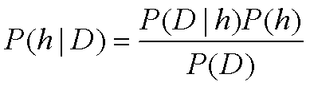


Intuition of Bayes Theorem
MAP : f ($θ$ | X₁ , X₂ .....X_{n})
MLE: f (X₁ , X₂ .....X_{n} | $θ$)
P(h) = prior probability of hypothesis h
P(D) = prior probability of training data D
P(h|D) = probability of h given D
P(D|h) = probability of D given h
𝐿 𝜃 , probability of data given parameter 𝜃
After seeing data, posterior belief of 𝜃
likelihood
prior
posterior
𝑃 𝜃 data =
𝑃 data 𝜃 𝑃 𝜃
𝑃 data
Before seeing data,
prior belief of 𝜃
e.g. what is distribution over parameters θ

Slide 11
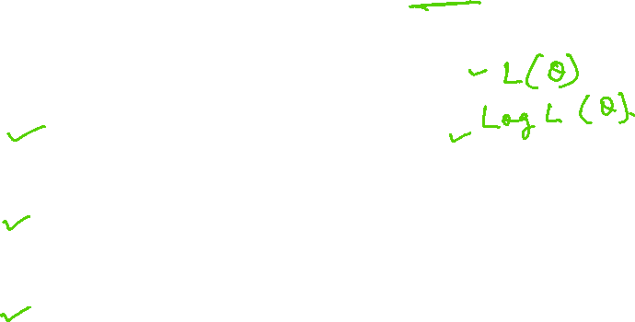
Maximum Likelihood Estimation (MLE)
Determine formula for 𝐿𝐿(𝜃)
Differentiate 𝐿𝐿(𝜃) w.r.t. (each) 𝜃
Solve

Slide 12

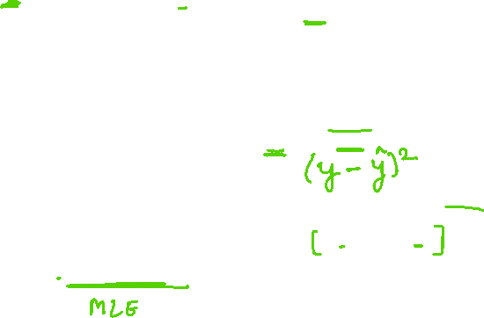
MLE – Linear Regression Model
Given the noise ε^{(i)} obeys a Normal distribution each y^{(i)} must also obey a Normal distribution around the true target value
Mileage (in kmpl) | Car Price (in cr)
9.8 | 10.48
9.12 | 1.75
9.5 | 6.95
10 | 2.51
CarPrice = 8.5 + 0.5 Mileage – 1.5 Mileage²
y^{(i)} = θ^{T} x^{(i)} + ε^{(i)}
ε^{(i)} ∼ N(0, σ²)
Parameters : ($θ$₀, $θ$₁, $θ$₂)
Find $θ=(θ\text{0}\text{, }θ\text{1}\text{, }θ\text{2})$ from the data X_{i}
ie., (Mileage_{i}, CarPrice_{i})
y^{(i)} | x^{(i)}; θ ∼ N(θ^{T} x^{(i)}, σ²)
  Maximum Likelihood Estimation (MLE)
    select that parameters 𝜃 that make the observed data the most likely
f (X₁ , X₂ .....X_{n} | $θ$)

Slide 13

MLE – Linear Regression Model
Determine formula for 𝐿𝐿(𝜃)
Differentiate 𝐿𝐿(𝜃) w.r.t. (each) 𝜃
Solve
Mileage (in kmpl) | Car Price (in cr)
9.8 | 10.48
9.12 | 1.75
9.5 | 6.95
10 | 2.51
MLE answers the question: For which parameter value does the observed data have the largest probability?

Slide 14
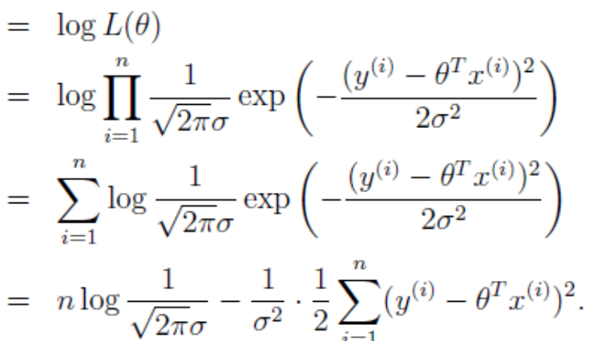

MLE – Linear Regression Model
Determine formula for 𝐿𝐿(𝜃)
Differentiate 𝐿𝐿(𝜃) w.r.t. (each) 𝜃
Solve
Mileage (in kmpl) | Car Price (in cr)
9.8 | 10.48
9.12 | 1.75
9.5 | 6.95
10 | 2.51

Slide 15
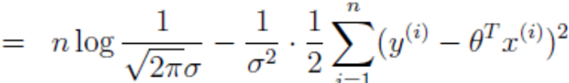

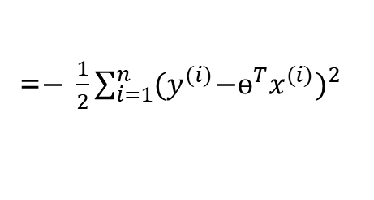
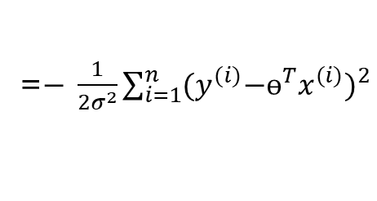
MLE – Linear Regression Model
Determine formula for 𝐿𝐿(𝜃)
Differentiate 𝐿𝐿(𝜃) w.r.t. (each) 𝜃
Solve
=$− \frac{1}{{2σ}^{2}}\sum_{i=1}^{n}{{{(y}^{(i)}{−ɵ^{T}x}^{(i)})}^{2}}$
=$− \frac{1}{2}\sum_{i=1}^{n}{{{(y}^{(i)}{−ɵ^{T}x}^{(i)})}^{2}}$

Slide 16
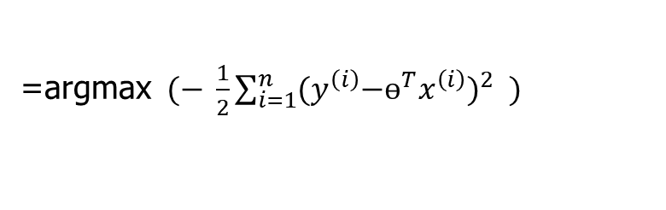

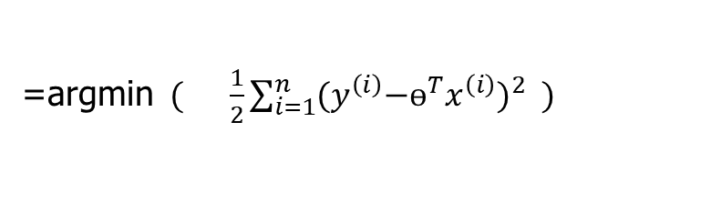
MLE – Linear Regression Model
Determine formula for 𝐿𝐿(𝜃)
Differentiate 𝐿𝐿(𝜃) w.r.t. (each) 𝜃
Solve
=$− \frac{1}{{2σ}^{2}}\sum_{i=1}^{n}{{{(y}^{(i)}{−ɵ^{T}x}^{(i)})}^{2}}$
=$− \frac{1}{2}\sum_{i=1}^{n}{{{(y}^{(i)}{−ɵ^{T}x}^{(i)})}^{2}}$
=argmax$(− \frac{1}{2}\sum_{i=1}^{n}{{{(y}^{\left(i\right)}{−ɵ^{T}x}^{\left(i\right)})}^{2}} )$
=argmin$( \frac{1}{2}\sum_{i=1}^{n}{{{(y}^{\left(i\right)}{−ɵ^{T}x}^{\left(i\right)})}^{2}} )$
With probabilistic assumptions on the data, least-squares regression corresponds to finding the MLE of θ

Slide 17
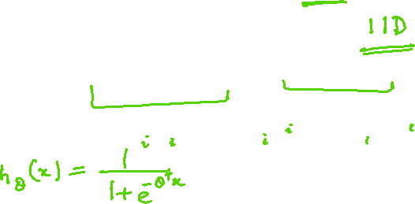
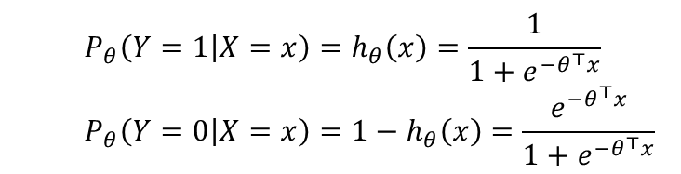

MLE – Logistic Regression
Determine formula for 𝐿𝐿(𝜃)
Differentiate 𝐿𝐿(𝜃) w.r.t. (each) 𝜃
Solve
$$LL\left(θ\right)=\log{\prod_{i=1}^{n}{P_{θ}\left(y^{(i)}|x^{\left(i\right)}\right)}}= \sum_{i=1}^{n}{\log{P_{θ}\left(y^{(i)}|x^{\left(i\right)}\right)}}$$
Mileage (in kmpl) | Car Price (in cr)
9.8 | High
9.12 | Low
9.5 | High
10 | Low
Bernoulli MLE Estimation
X₁,X₂,….,X_{n} where X_{i} ~ Ber(p). PMF of a Bernoulli
  $$P_{θ}\left(Y=1 | X=x\right)=h_{θ}\left(x\right)=\frac{1}{1+e^{{−θ}^{⊤}x}}$$
  $$P_{θ}\left(Y=0 | X=x\right)=1−h_{θ}\left(x\right)=\frac{e^{{−θ}^{⊤}x}}{1+e^{{−θ}^{⊤}x}}$$
MLE answers the question: For which parameter value does the observed data have the largest probability?

Slide 18
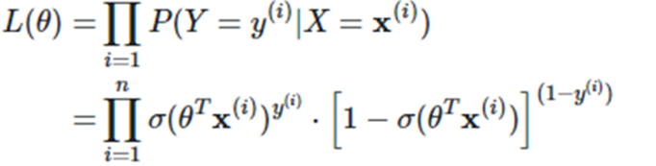
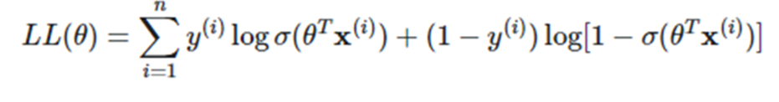
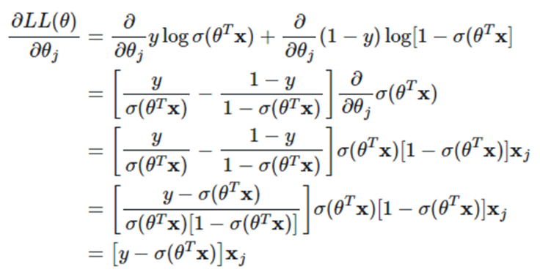
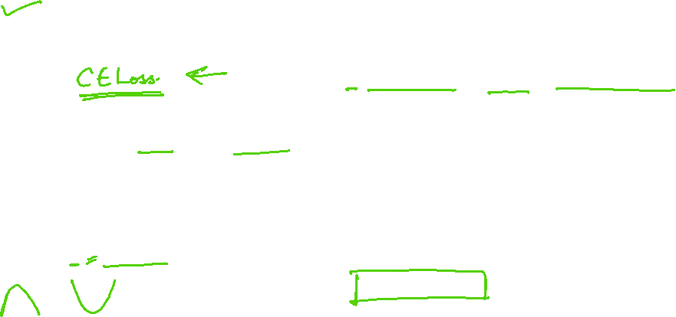
MLE – Logistic Regression
Determine formula for 𝐿𝐿(𝜃)
Differentiate 𝐿𝐿(𝜃) w.r.t. (each) 𝜃
Solve
MLE answers the question: For which parameter value does the observed data have the largest probability?

Slide 19


MLE – Logistic Regression
Determine formula for 𝐿𝐿(𝜃)
Differentiate 𝐿𝐿(𝜃) w.r.t. (each) 𝜃
Solve
MLE answers the question: For which parameter value does the observed data have the biggest probability?

Slide 20
MLE-Summary
Consider a sample of 𝑛 i.i.d. random variables 𝑋₁, 𝑋₂,…, 𝑋_{n}, drawn from a distribution 𝑓(𝑋_{i}|𝜃)
𝜃_{MLE} maximizes the likelihood of data, 𝐿 (𝜃) and 𝐿𝐿 (𝜃)

Slide 21
Additional Problems in MLE

Slide 22
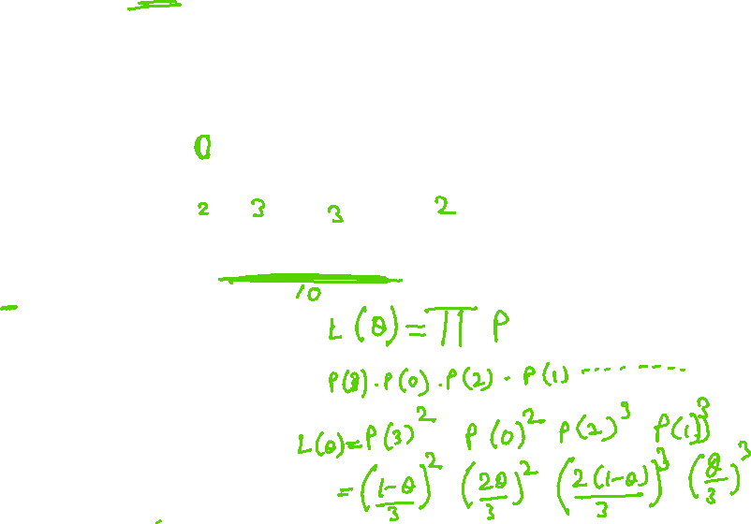
MLE – Discrete - PMF
Determine formula for 𝐿𝐿(𝜃)
Differentiate 𝐿𝐿(𝜃) w.r.t. (each) 𝜃
Solve

Slide 23
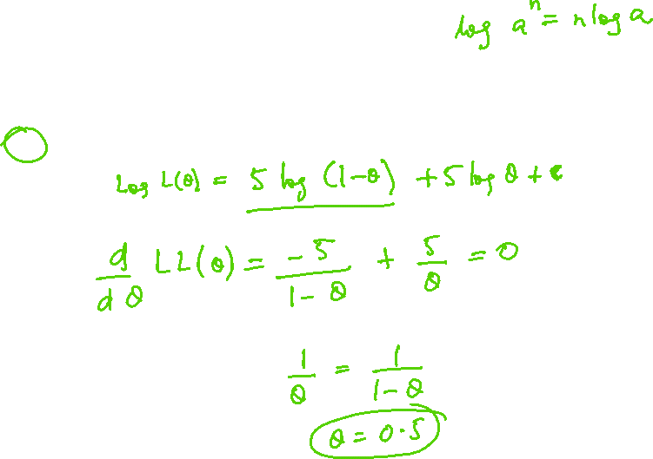
MLE – Discrete - PMF
Determine formula for 𝐿𝐿(𝜃)
Differentiate 𝐿𝐿(𝜃) w.r.t. (each) 𝜃
Solve
X | P(X)
3 | (1-ɵ) / 3
0 | 2ɵ / 3
2 | 2(1-ɵ) / 3
1 | ɵ/ 3
3 | (1-ɵ) / 3
2 | 2(1-ɵ) / 3
1 | ɵ/ 3
0 | 2ɵ / 3
2 | 2(1-ɵ) / 3
1 | ɵ/ 3
L(ɵ) = P(X=3)*P(X=0)*P(X=2)*……..*P(X=1)
= ((1-ɵ) / 3)² * (2ɵ / 3)² * (2(1-ɵ) / 3)³ * (ɵ/ 3)³

Slide 24

MLE – Discrete - PMF
Determine formula for 𝐿𝐿(𝜃)
Differentiate 𝐿𝐿(𝜃) w.r.t. (each) 𝜃
Solve
L(ɵ) = P(X=3)*P(X=0)*P(X=2)*……..*P(X=1)
= ((1-ɵ) / 3)² * (2ɵ / 3)² * (2(1-ɵ) / 3)³ * (ɵ/ 3)³
LL(ɵ) = log [((1-ɵ) / 3)² * (2ɵ / 3)² * (2(1-ɵ) / 3)³ * (ɵ/ 3)³]
= log ((1-ɵ) / 3)² + log (2ɵ / 3)² + log (2(1-ɵ) / 3)³ * log(ɵ/ 3)³
= 2log ((1-ɵ) / 3) + 2log (2ɵ / 3) + 3 log (2(1-ɵ) / 3) + 3log(ɵ/ 3)
=2(log ((1-ɵ) -log 3) + 2(log (2ɵ)-log3) + 3( log (2(1-ɵ)) – log3) + 3(log(ɵ)-log 3)
Gradient ( LL(ɵ) ) = - $\frac{2}{\text{(1−ɵ)}}+ \frac{2}{\text{ɵ}}−\frac{3}{\text{(1−ɵ)}}+ \frac{3}{\text{ɵ}}$
= $\frac{−\text{5}\text{ɵ}\text{ + }5−\text{5}\text{ɵ}}{\text{(1−ɵ)ɵ}}$= $\frac{−10\text{ɵ + }5}{\text{(1−ɵ)ɵ}}$ = $0$➔ $\text{ɵ}$ = 0.5

Slide 25
Additional Exercise for Student’s Practice
Consider inputs x_{i} which are real valued attributes and the outputs y_{i} which are real
valued of the form , where f(x_{i}) is the true function and e_{i} is a random variable representing laplacian noise with PDF given by
Implementing a linear regression model of the form , and ,
find the maximum likelihood estimator of è. Comment on the loss function.

Slide 26

Additional Exercise for Student’s Practice
Determine formula for 𝐿𝐿(𝜃)
Differentiate 𝐿𝐿(𝜃) w.r.t. (each) 𝜃
Solve
L(ɵ) = L(ɵ) = ${\frac{1}{\text{2}\text{ɵ}} e}^{\frac{\text{−|}\text{y} \text{1 }\text{− }μ\text{|}}{\text{ɵ}}}$ *${\frac{1}{\text{2}\text{ɵ}} e}^{\frac{\text{−|}\text{y} \text{2 }\text{− }μ\text{|}}{\text{ɵ}}}$*${\frac{1}{\text{2}\text{ɵ}} e}^{\frac{\text{−|}\text{y}\text{ 3} \text{− }μ\text{|}}{\text{ɵ}}}$ *……..*${\frac{1}{\text{2}\text{ɵ}} e}^{\frac{\text{−|}\text{y} \text{n}\text{ − }μ\text{|}}{\text{ɵ}}}$
=${(\prod_{i=1}^{n}{{\frac{1}{\text{2}\text{ɵ}} e}^{\frac{\text{−|}\text{y} \text{i} \text{− }μ\text{|}}{\text{ɵ}}})} }^{}$
LL(ɵ) = ln $(\prod_{i=1}^{n}{{\frac{1}{\text{2}\text{ɵ}} e}^{\frac{\text{−|}\text{y} \text{i} \text{− }μ\text{|}}{\text{ɵ}}})}$ = - $\text{l}n (\text{2}\text{ɵ}) \sum_{i=1}^{n}{1}$ + $\sum_{i=1}^{n}{\text{l}n (e^{\frac{\text{−|}\text{y} \text{i} \text{− }μ\text{|}}{\text{ɵ}}})}$
= ${}_{\text{ɵ}}^{argmax}$- n $\text{l}n (\text{2}\text{ɵ})$ - $\sum_{i=1}^{n}{\frac{\text{|}\text{y} \text{i} \text{− }μ\text{|}}{\text{ɵ}}}$
= ${}_{\text{ɵ}}^{argmin}$n $\text{l}n (\text{2}\text{ɵ})$ + $\sum_{i=1}^{n}{\frac{\text{|}\text{y} \text{i} \text{− }μ\text{|}}{\text{ɵ}}}$
Gradient ( LL(ɵ) ) = $\frac{n}{\text{(ɵ)}} −\frac{\sum_{i=1}^{n}{\text{|}\text{y} \text{i} \text{− }μ\text{|}}}{\text{(ɵ}2\text{)}}$= $0$
$\frac{n}{\text{(ɵ)}}=\frac{\sum_{i=1}^{n}{\text{|}\text{y} \text{i} \text{− }μ\text{|}}}{\text{(ɵ}2\text{)}}$
$\text{ɵ}=\frac{\sum_{i=1}^{n}{\text{|}\text{y} \text{i} \text{− }μ\text{|}}}{\text{n}}$ Instead of MSE, MAE is the maximum likelihood hypothesis. So MAE is appropriate for the loss function

Slide 27
References
https://www.inf.ed.ac.uk/teaching/courses/inf2b/learnnotes/inf2b-learn07-notes-nup.pdf
https://cs229.stanford.edu/summer2019/cs229-notes2.pdf
Tom Mitchell – Chapter 6
https://nlp.stanford.edu/IR-book/pdf/13bayes.pdf

Slide 28
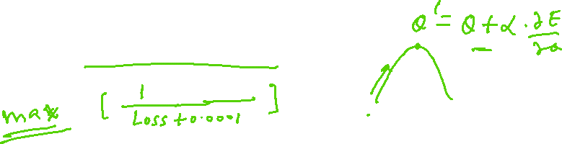
Thank you !
Required Reading for completed session :
T1 - Chapter # 8 (Tom M. Mitchell, Machine Learning)
T1 - Chapter # 6 (Tom M. Mitchell, Machine Learning)
R1 – Chapter # 3 (Christopher M. Bhisop, Pattern Recognition & Machine Learning) & Refresh your MFDS & ISM parallel course basics
Next Session Plan :
Module 9 : Ensemble Learning

